Slide 1

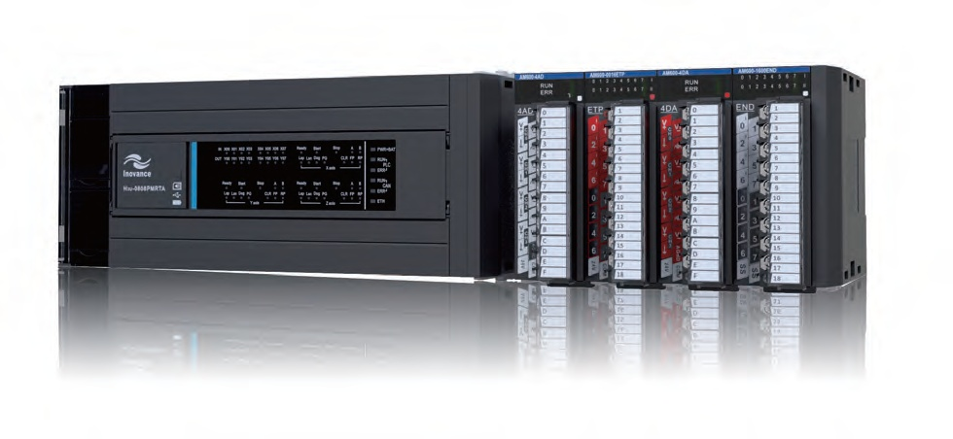
Servo | AC Drive | PLC | Motor | Robotic | IOT | Renewable Energy
H3U
PartⅡ
Technology
High Performance Small PLC
PMT Eric Weng
Dec,2016
Forward, Always Progressing!
Version 1.0

Slide 2


CONTENTS
PART 1
Installation Practice
PART 2
Wiring Specifications
PART 3
Getting Started
PART 4
Diagnostics
Technical

Slide 3

1. Installation Practice
1.1 Installation Environment
1.2 Mounting Orientation and Clearance
1.3 Installation Method and Procedures
1.4 Recommended External Components

Slide 4
PART 1
Installation Practice
1.1 Installation Environment
Item | Specifications
Ambient temperature | Running: -5~55°C, storage: -25~75°C
Relative humidity | Running: 5~95%RH (non-condensing)
Vibration |  | Frequency (Hz) | Acceleration (m/s²) | One-way amplitude (mm) | Ten times in each of the X, Y and Z direction for 80 minutes
 | When DIN rail is installed | 10~57 | -- | 0.035
 |  | 57~150 | 4.9 | --
 | When PLC is directly installed | 10~57 | -- | --
 |  | 57~150 | 9.8 | 0.075
Working environment | Do not use the PLC in environments with strong erosive and flammable gases or conductive dust.
Elevation | Below 2000 m

Slide 5
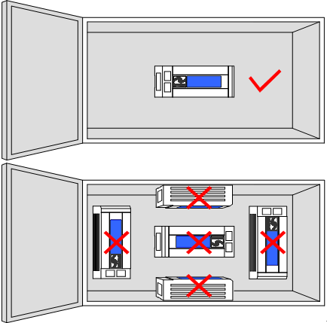
PART 1
Installation Practice
1.2 Mounting Orientation and Clearance
Vertical upward installation

Slide 6
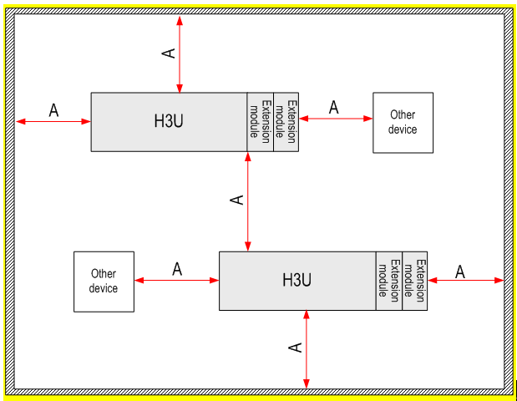
PART 1
Installation Practice
1.2 Mounting Orientation and Clearance
To ensure properly ventilation, the distance A between the PLC and modules should be larger than 50 mm.

Slide 7
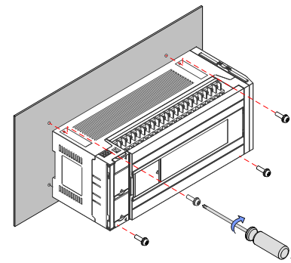
PART 1
Installation Practice
1.3 Installation Method and Procedures
Backplate Mounting
Use M4 screws to fix the PLC on the installation surface in the control cabinet through the mounting holes on four corners

Slide 8
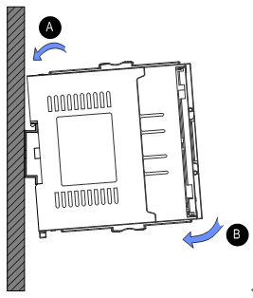
PART 1
Installation Practice
1.3 Installation Method and Procedures
DIN Rail Mounting
1.Clip the mounting slot on the rear side of the PLC in the upper edge of the rail.
2. Press the PLC in the direction B until you hear the click sound. Check if the PLC is fully and vertically clipped in on the DIN rail.

Slide 9
PART 1
Installation Practice
1.3 Installation Method and Procedures
DIN Rail Mounting
1.Clip the mounting slot on the rear side of the PLC in the upper edge of the rail.
2. Press the PLC in the direction B until you hear the click sound. Check if the PLC is fully and vertically clipped in on the DIN rail.

Slide 10
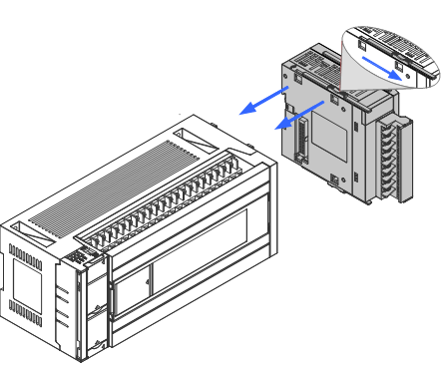
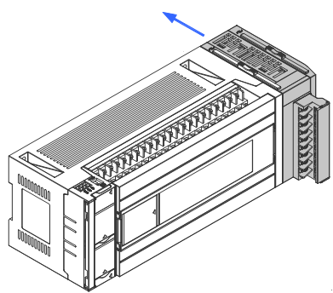
PART 1
Installation Practice
1.3 Installation Method and Procedures
Expansion Modules Installation
Unlock
Lock

Slide 11
CONTENTS
PART 1
Installation Practice
PART 2
Wiring Specifications
PART 3
Getting Started
PART 4
Diagnostics
Technical

Slide 12
2. Wiring Specifications
2.1 Terminals
2.2 Input Wiring
2.3 Output Wiring
2.4 Communication Instructions

Slide 13
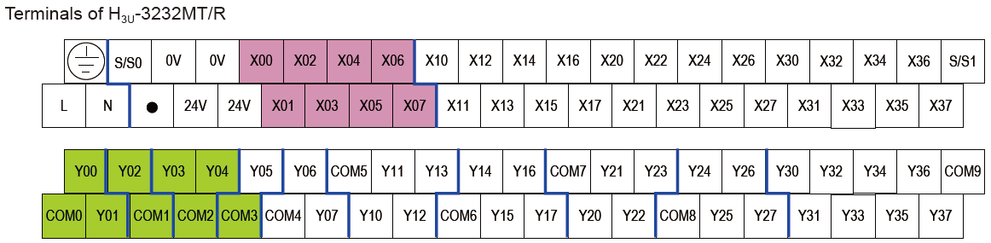
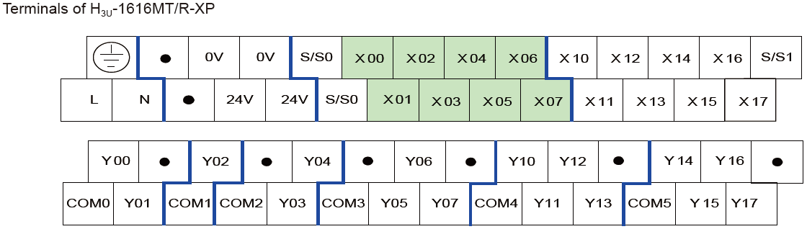
PART 2
Wiring Specifications
2.1 Terminals

Slide 14
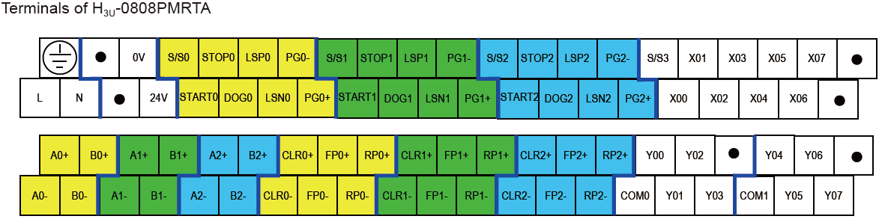
PART 2
Wiring Specifications
2.1 Terminals

Slide 15
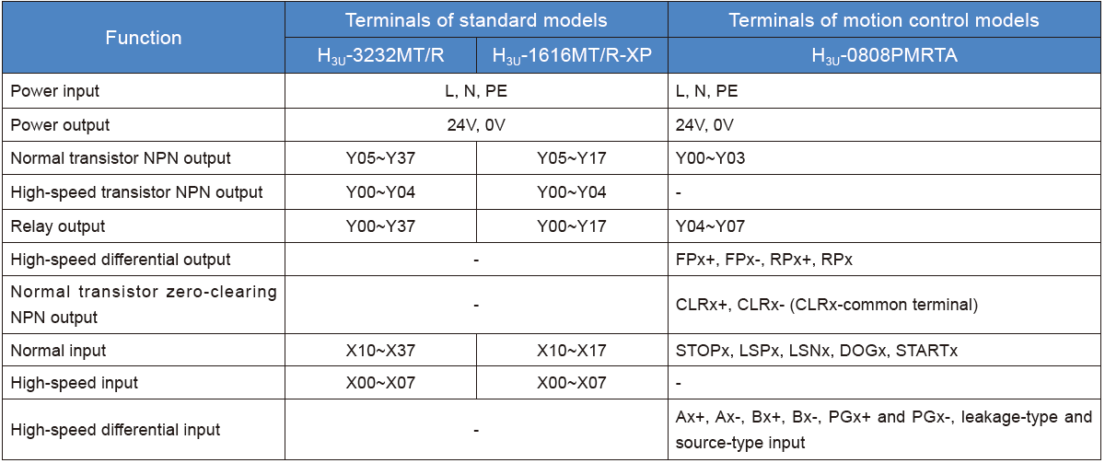
PART 2
Wiring Specifications
2.1 Terminals

Slide 16
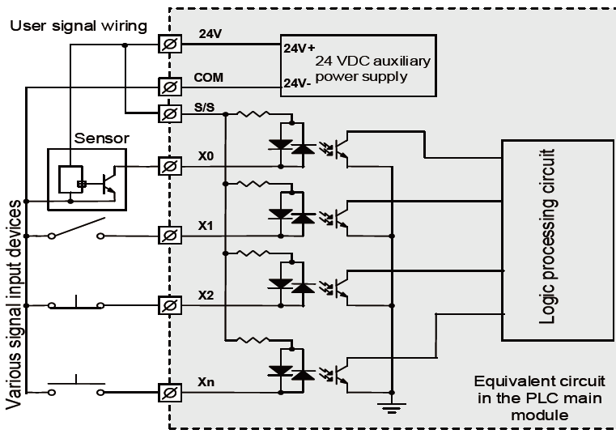
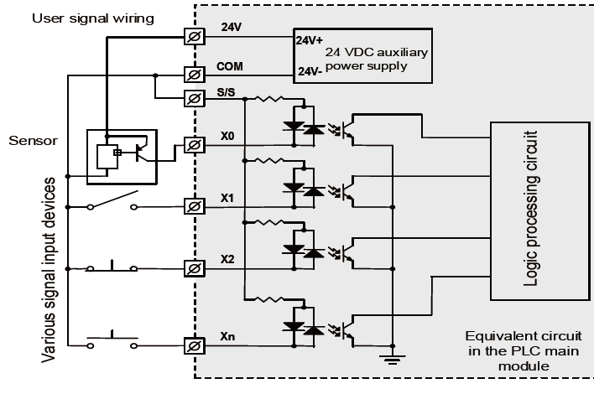
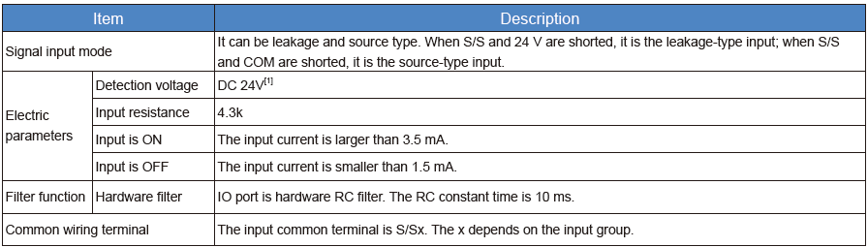
PART 2
Wiring Specifications
2.2 Input Wiring
Normal input wiring
Leaking type
Source type

Slide 17
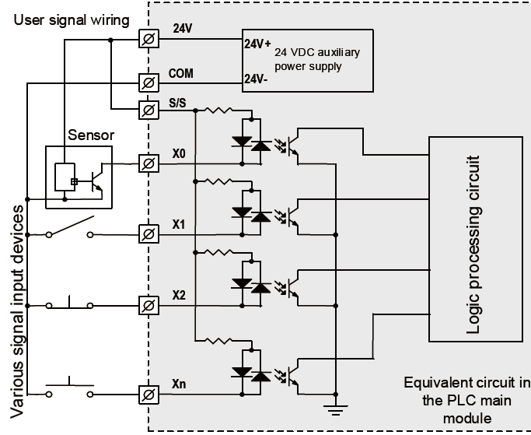
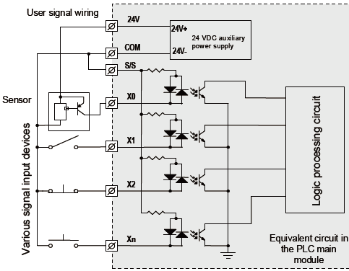
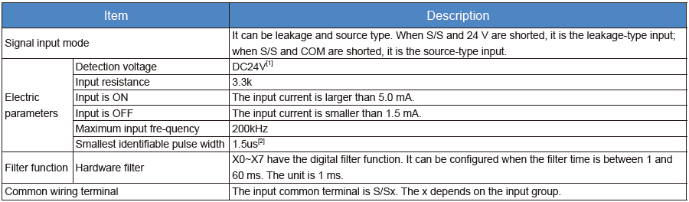
PART 2
Wiring Specifications
2.2 Input Wiring
High-speed input wiring
Leaking type
Source type

Slide 18
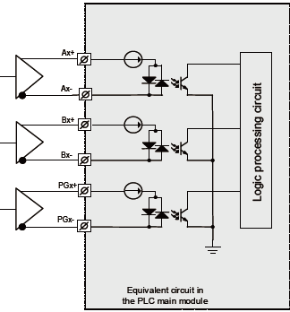
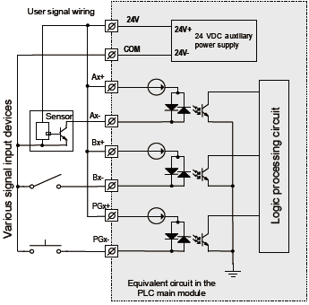
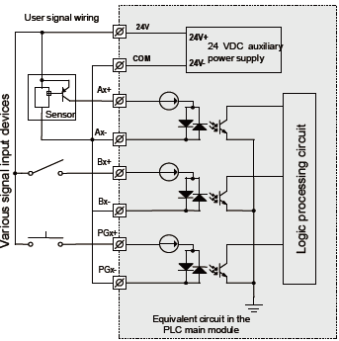
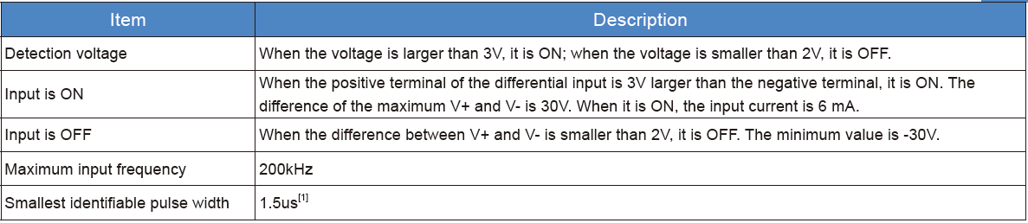
PART 2
Wiring Specifications
2.2 Input Wiring
Differential input wiring
Standard method
Leaking type
Source type

Slide 19
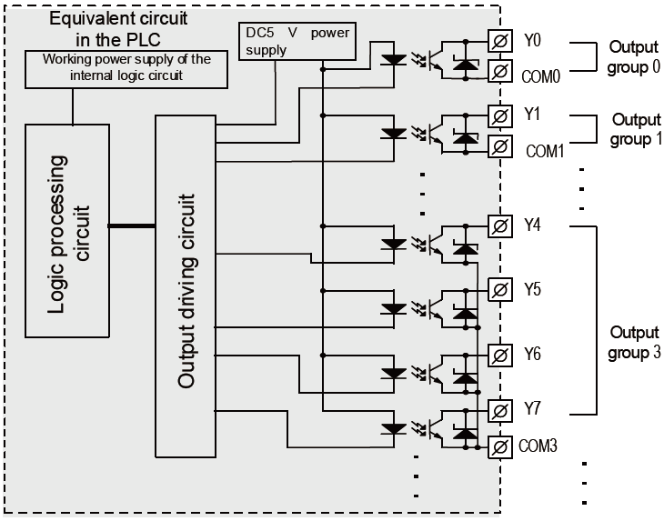
PART 2
Wiring Specifications
2.3 Output Wiring
Normal/high-speed transistor output wiring

Slide 20
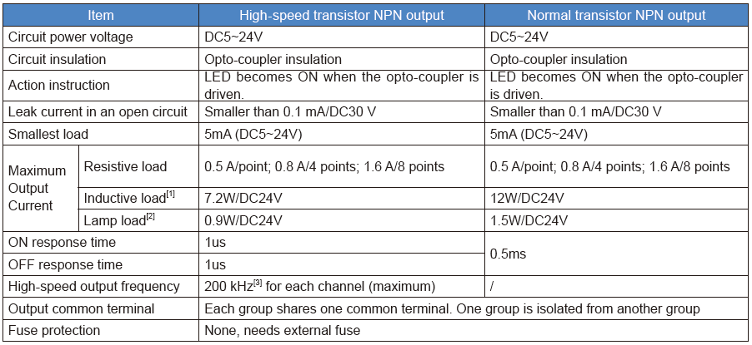
PART 2
Wiring Specifications
2.3 Output Wiring

Slide 21
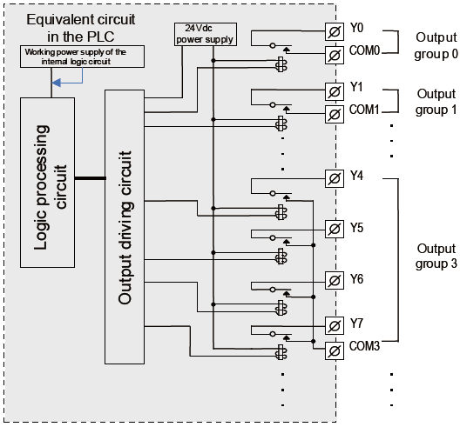
PART 2
Wiring Specifications
2.3 Output Wiring
Wiring of relay outputs

Slide 22
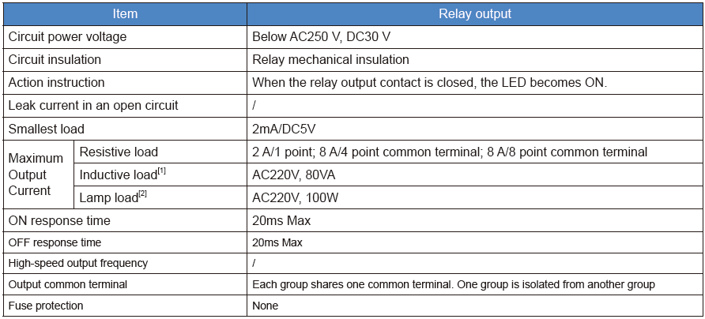
PART 2
Wiring Specifications
2.3 Output Wiring

Slide 23
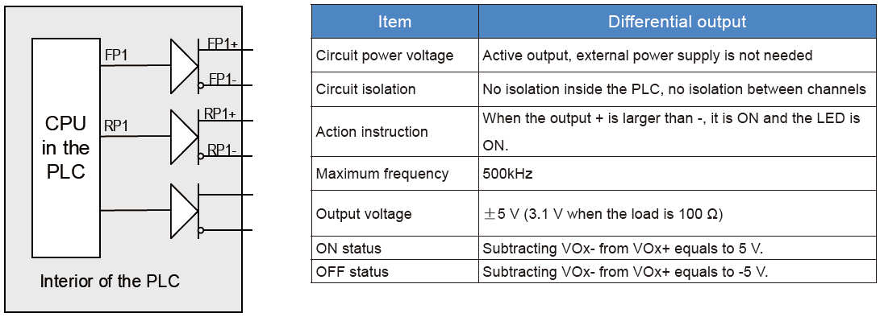
PART 2
Wiring Specifications
2.3 Output Wiring
Wiring of High-speed differential outputs

Slide 24
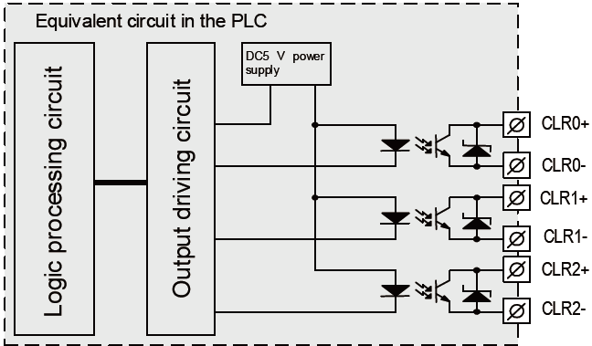
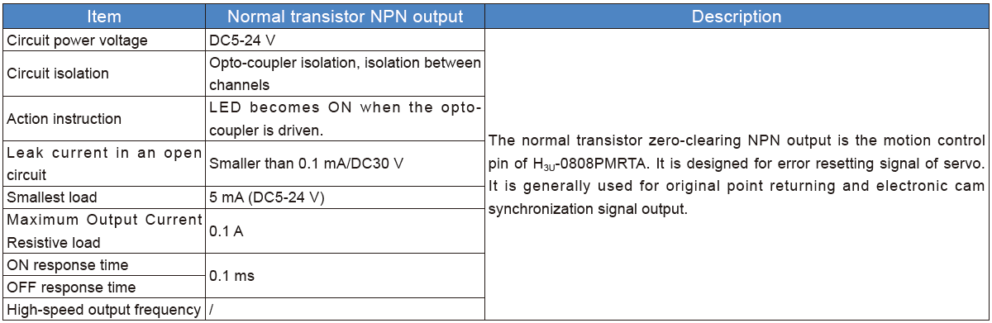
PART 2
Wiring Specifications
2.3 Output Wiring
CLR outputs of H3U-0808PMRTA

Slide 25
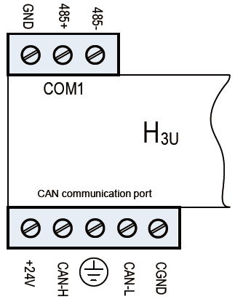
PART 2
Wiring Specifications
2.4 Communication Instructions
Functions of communication terminals
Name | Description
+24V,CGND | CAN communication power supply, setting range is between 9-30 V
CANL,CANH | CAN communication cable, the reference level is CGND. CGNDs must be connected to each other when there are multiple stations.
 | It is the shield layer, which should be connected according to the actual need.
485+, 485- | It is used to connect the RS485 communication signal cable.
GND | It is for the reference signal of the RS485 communication signal.

Slide 26
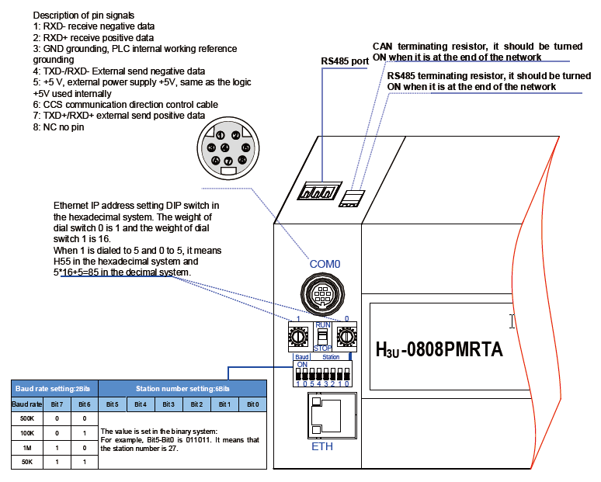
PART 2
Wiring Specifications
2.4 Communication Instructions
Communication configuration of H3U-3232MT/R and H3U-0808PMRTA

Slide 27
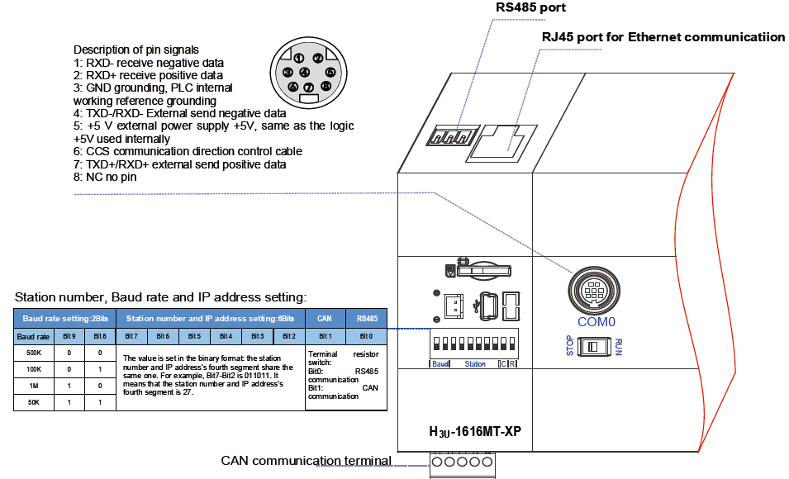
PART 2
Wiring Specifications
2.4 Communication Instructions
Communication configuration of
H3U-1616MT/R-XP

Slide 28
CONTENTS
PART 1
Installation Practice
PART 2
Wiring Specifications
PART 3
Getting Started
PART 4
Diagnostics
Technical

Slide 29
3. Getting Started
3.1 Tools Requirements
3.2 Hardware Connection
3.3 Installation of AutoShop
3.4 Program Download Procedure

Slide 30
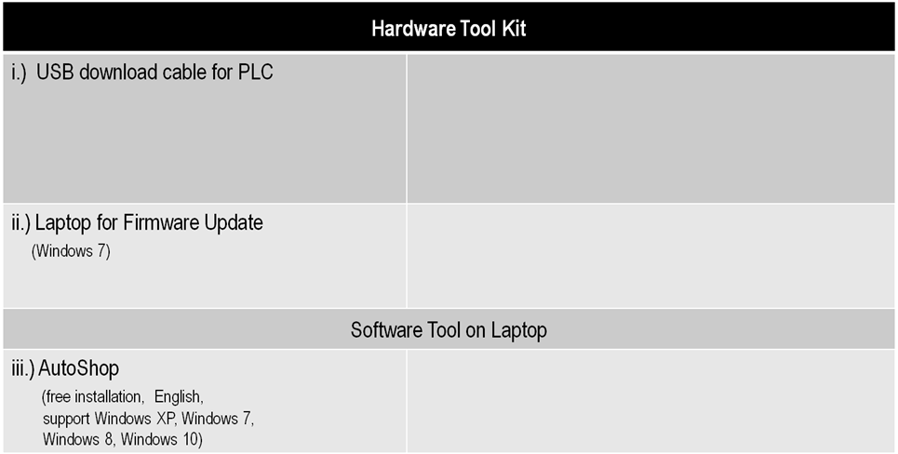
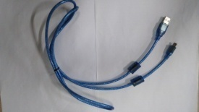



PART 3
Getting Started
3.1 Tools Requirements
USB2.0 to Laptop
Part Code：15041200
mini USB to PLC

Slide 31
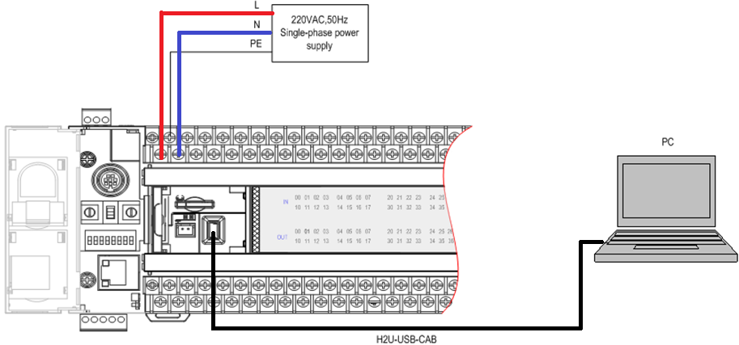
PART 3
Getting Started
3.2 Hardware Connection

Slide 32
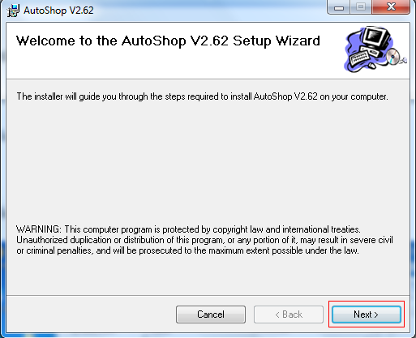
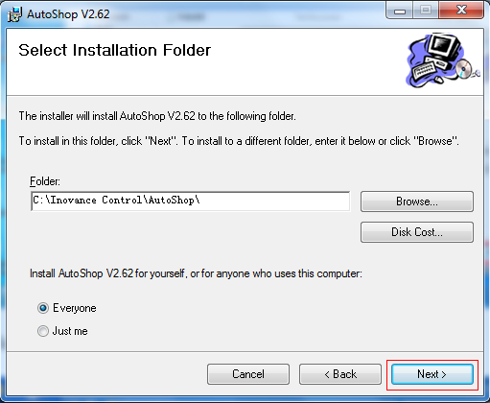
PART 3
Getting Started
3.3 Installation of AutoShop
Step 1: Double click the(the present version is V2.62 for English.)
Step 2: Click “Next” and “Next” .

Slide 33
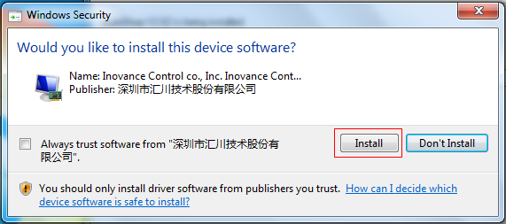
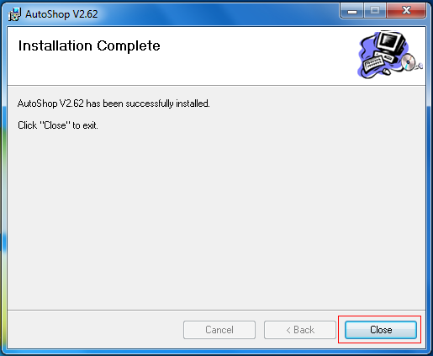
PART 3
Getting Started
3.3 Installation of AutoShop
Step 3: Click “Install”.
Step 4: Wait until the installation complete, click “Close”. Finished

Slide 34
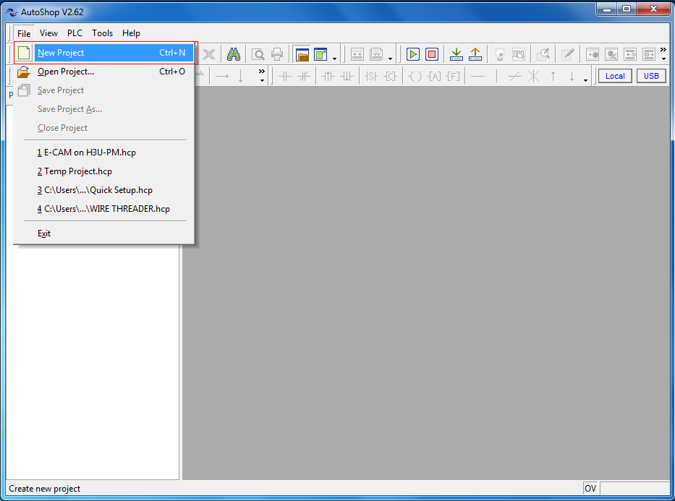
PART 3
Getting Started
3.4 Program Download Procedure
Step 1:
1.Power on PLC
2.Double click the “AutoShop”
3.Click “File” and select “New Project”

Slide 35
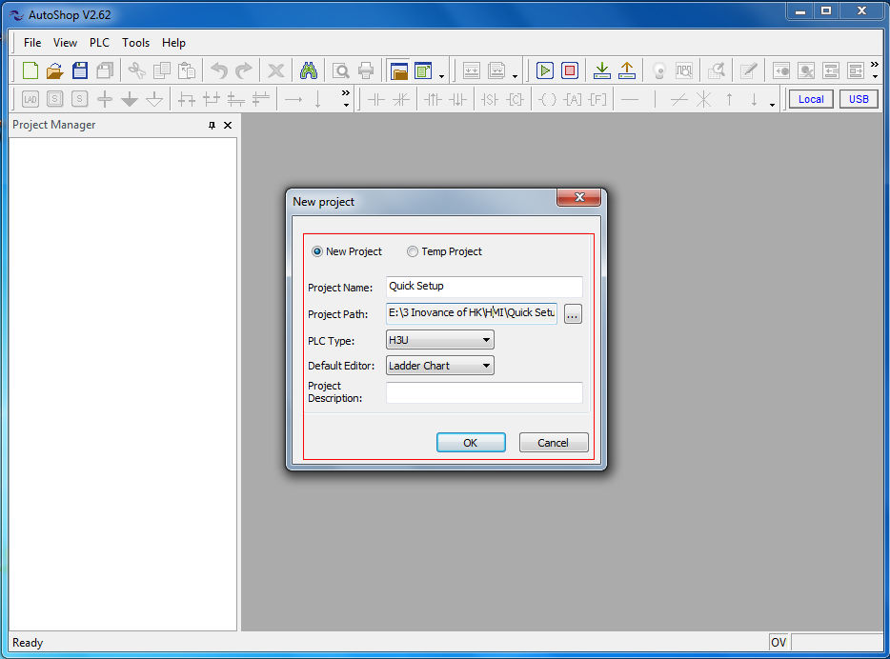
PART 3
Getting Started
3.4 Program Download Procedure
Step 2: Set as follows figure.

Slide 36
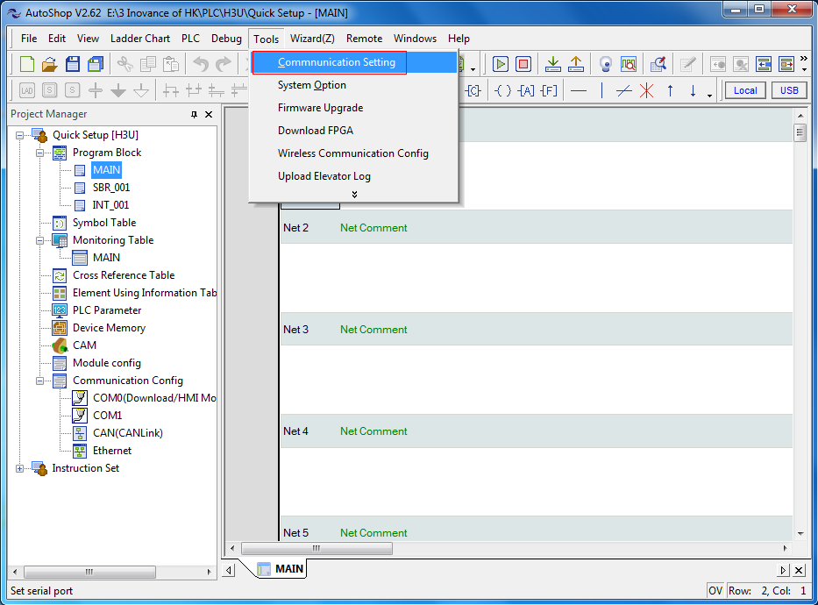
PART 3
Getting Started
3.4 Program Download Procedure
Step 3:Click “Tools” and select “Communication Setting” .

Slide 37
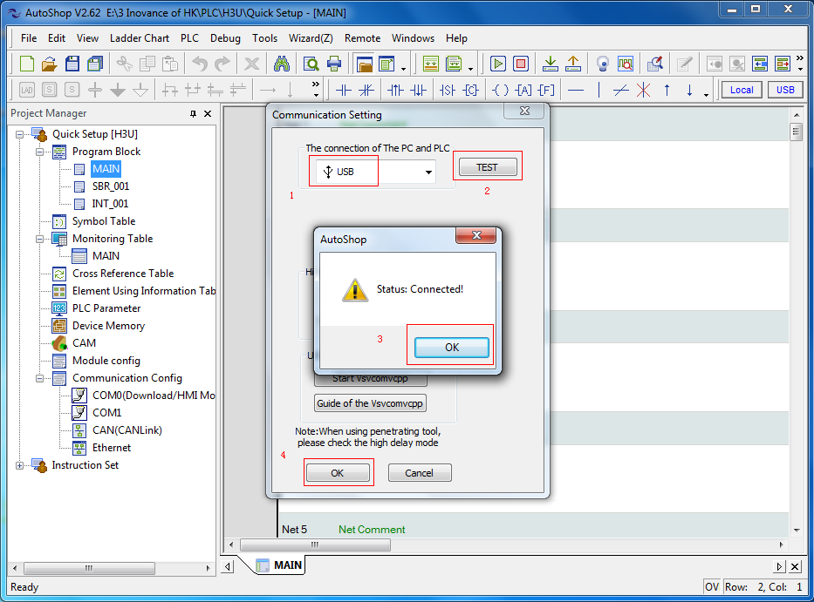
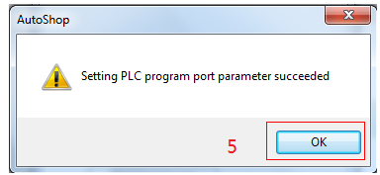
PART 3
Getting Started
3.4 Program Download Procedure
Step 4: Follow below steps1-2-3-4.

Slide 38
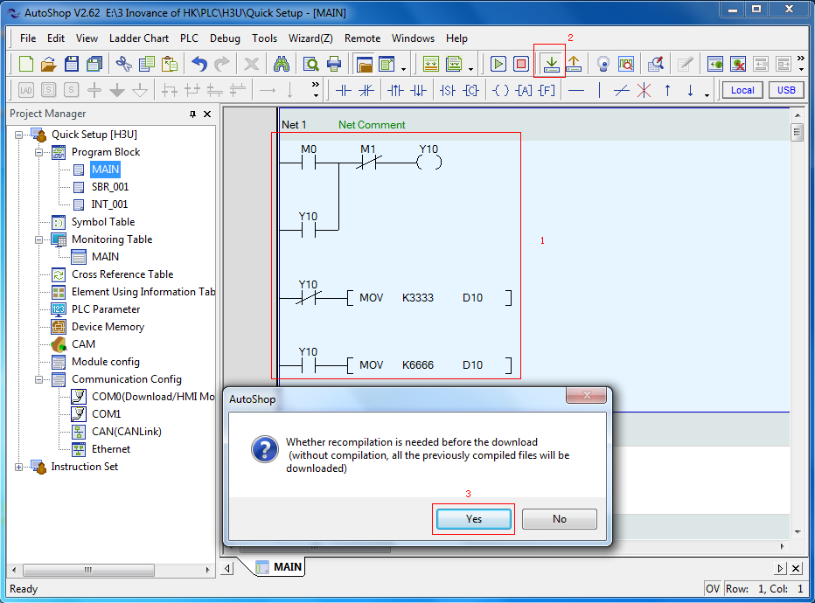
PART 3
Getting Started
3.4 Program Download Procedure
Step 5: When you finish coding, follow below step to download program.

Slide 39
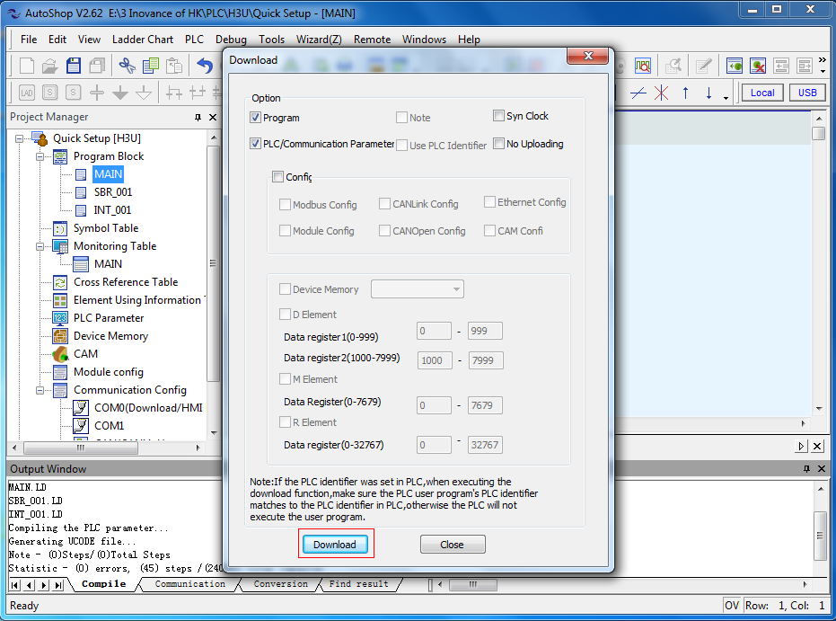
PART 3
Getting Started
3.4 Program Download Procedure
Step 5: When you finish coding, follow below step to download program.

Slide 40
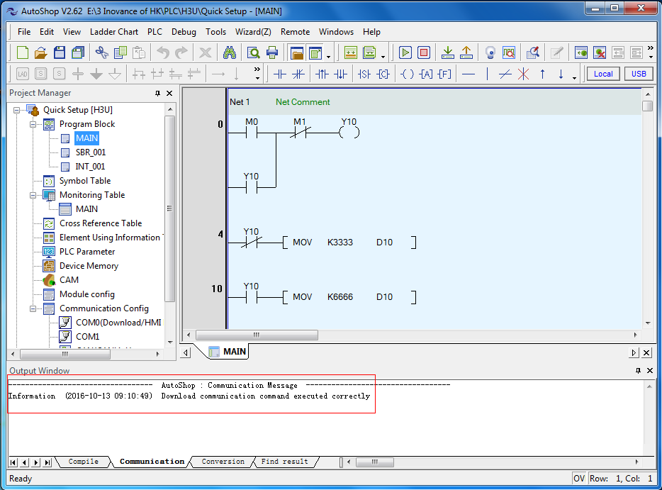
PART 3
Getting Started
3.4 Program Download Procedure
Step 6:The output window indicates the download executed .

Slide 41
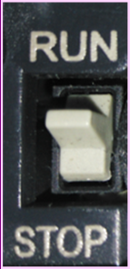
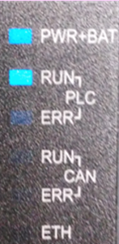
PART 3
Getting Started
3.4 Program Download Procedure
Step 9:
1.Switch to the “RUN”.
2.The RUN light is ON.

Slide 42
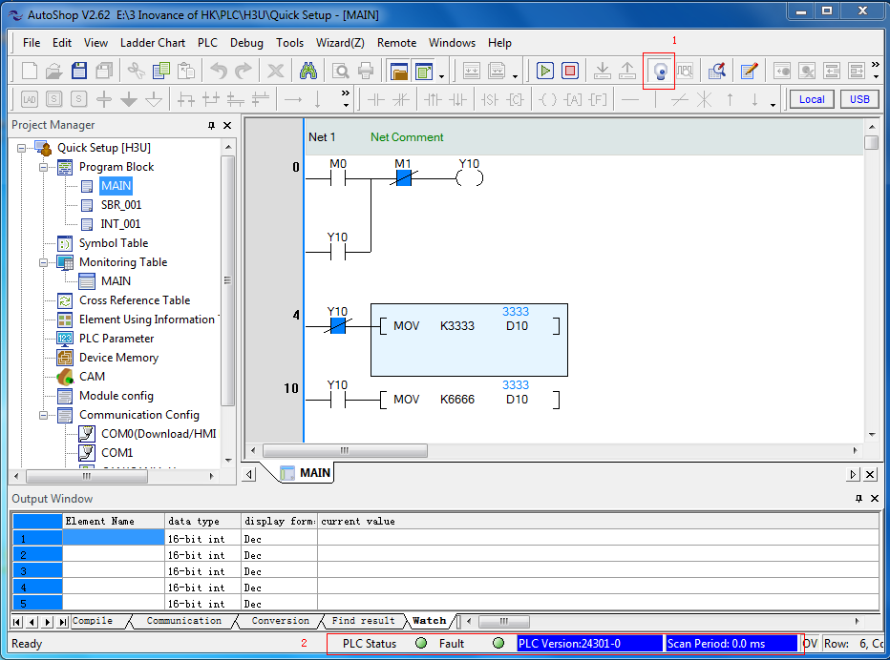
PART 3
Getting Started
3.4 Program Download Procedure
Step 10:
1.Click “monitor” widget to start monitoring program.
2.The lamps of PLC Status and Fault turn green.

Slide 43
CONTENTS
PART 1
Installation Practice
PART 2
Wiring Specifications
PART 3
Getting Started
PART 4
Diagnostics
Technical

Slide 44
4. Diagnostics
4.1 Common Faults Expressed by Fault Codes

Slide 45
PART 4
Diagnostics
4.1 Common Faults Expressed by Fault Codes
Error Code | Content
D8060 | I/O range or setting error
1000-1377 | X input signal error, serial number error or exceeding limit
0000-0377 | Y input signal error, serial number error or exceeding limit

Slide 46
PART 4
Diagnostics
4.1 Common Faults Expressed by Fault Codes
Error Code | Content
D8061 | PC hardware error definition
6101 | RAM error
6102 | Operation loop error
6103 | I/O hardware connection error
6104 | External 24V power error
6105 | System monitor error
6106 | System flash read/write error
6107 | System I/O setting error
6108 | FPGA download error
6109 | FPGA configuration data error in flash
6110 | Ethernet hardware initialization failure
6111 | Extension module configuration different from the actual
6112-6199 | Reserved
16100-16199 | Reserved
26100-26199 | Reserved

Slide 47
PART 4
Diagnostics
Error Code | Content
D8062 | Communication error in control panel or program connection port
6200-6279 serial communication and configuration error codes
6201 | Receiving timeout
6202 | CAN transmitting busy
6203 | CAN receiving busy
6204 | Data format incorrect
6205 | Instruction incorrect
6206 | Communication element exceeding range
6207 | Communication port exceeding range or not existing
6208-6279 | Reserved
6280-6299 | CAN communication configuration error code
16200-16219 Ethernet configuration error code
16200 | Reserved
16201 | Ethernet configuration: function codes not supported
16202 | Ethernet configuration: register start address incorrect or start address plus number of registers incorrect
16203 | Ethernet configuration: number of registers too large
16204 | Ethernet configuration: reading/writing register failed.
16205 | Ethernet configuration: ACK signal
16206 | Ethernet configuration: slave busy
16207 | Ethernet configuration: station number incorrect
16208 | Ethernet configuration: memory check error
16209 | Reserved
16210 | Ethernet configuration: gateway path error
16211 | Ethernet configuration: destination gateway path error
16212-16215 | Reserved
16216 | Ethernet configuration: IP address illegal
16217-16219 | Reserved
16220-16239 | Extension module configuration error code
16240-16259 | USB communication configuration error code
16260-16279 motion control configuration error code

Slide 48
PART 4
Diagnostics
4.1 Common Faults Expressed by Fault Codes
Error Code | Content
D8062 | Communication error in control panel or program connection port
16260 | Mechanical unit setting value incorrect
16261 | Electronic gear ratio setting value incorrect
16262 | Cam table not configured in software being used
16263 | No external input master axis selected for electronic cam
16264 | Electronic cam slave axis speed exceeding maximum output speed allowed
16265 | Synchronization lower limit larger than upper limit
16266 | Master axis setting exceeding range
16267 | Delayed startup pulses setting incorrect
16268 | Instruction written in cam key point, value of key point illegal
16269 | Cam encrypted, not allowing instruction to read key point data
16270 | Electronic cam slave axis zooming incorrect
16271 | Electronic cam configuration unit incorrect
16272 | Failure in modifying electronic cam during running
16273 | Electronic cam modification instruction used repeatedly
16274-16279 | Reserved
16280-16299 | Reserved
26200-26299 | Reserved

Slide 49
PART 4
Diagnostics
4.1 Common Faults Expressed by Fault Codes
Error Code | Content
D8063 | Communication error
6300-6379 COM0 to COMx serial communication error code
6301 | Odd/Even check error, overflow error, frame error
6302 | Communication character incorrect
6303 | Communication data sum inconsistent
6304 | Data format incorrect
6305 | Instruction incorrect
6306 | Monitor timer timeout
6307 | Reserved
6308 | Reserved
6309 | Reserved
6310 | Reserved
6311 | Reserved
6312 | Parallel control (1:1) protocol character incorrect
6313 | Parallel control (1:1) protocol sum incorrect
6314 | Parallel control (1:1) protocol format incorrect
6315 | Parallel control (1:1) protocol communication timeout
6316-6329 | Reserved

Slide 50
PART 4
Diagnostics
4.1 Common Faults Expressed by Fault Codes
Error Code | Content
D8063 | Communication error
6330+10*X | Modbus slave address setting incorrect, address larger than 247
6331+10*X | Data frame length incorrect, returned frame length not meeting requirement, or smaller than 5
6332+10*X | Address incorrect, standard error frame; transmit/receive addresses inconsistent
6333+10*X | CRC check error
6334+10*X | Instruction code not supported, standard error frame; transmit/receive instructions inconsistent; instruction not supported
6335+10*X | Receiving timeout
6336+10*X | Data error, standard error frame
6337+10*X | Reserved
6338+10*X | Frame error, standard error frame
6339+10*X | Serial protocol error, not configuring corresponding protocol when using Modbus or RS instruction

Slide 51
PART 4
Diagnostics
4.1 Common Faults Expressed by Fault Codes
Error Code | Content
D8063 | Communication error
6380– 6399: CAN communication error code
6380 | Transmitting timeout
6381 | Receiving timeout
6382 | CAN transmitting busy
6383 | CAN receiving busy
6384-6399 | Reserved
16300-16319 Ethernet communication error code
16300-16311 | Reserved
16312 | Protocol designator error Modbus protocol
16313 | Frame length error
16314 | Frame timeout error
16315 | Frame not recognized by slave (only for master)
16316 | IP address illegal
16317-16319 | Reserved
16320-16339 | Extension module communication error code
16340-16359 | USB communication error code
16360-16379 | Control panel and interface communication error code
16380-16399 | Reserved
26300-26399 | Reserved

Slide 52
PART 4
Diagnostics
4.1 Common Faults Expressed by Fault Codes
Error Code | Content
D8064 | System parameter setting incorrect
6401 | Program and parameter inconsistent
6402 | Program capacity setting incorrect
6403 | Changeable power failure retentive area of soft element setting incorrect
6404 | Parameter area setting incorrect
6405 | Program area setting incorrect
6406-6424 | Reserved
6425 | User program check error, download data incorrect
6426 | User program, including motion control subroutine program, incomplete
6427 | PLC designator and user program designator not matching
6428 | Factory commissioning error
6429-6452 | Reserved
6453-6465 | Changeable power failure retentive area of soft element setting incorrect
6466-6499 | Reserved
16400-16499 | Reserved
26400-26499 | Reserved

Slide 53
PART 4
Diagnostics
4.1 Common Faults Expressed by Fault Codes
Error Code | Content
D8065 | User program grammar error
6501 | Reserved
6502 | Reserved
6503 | Instruction parameter error
6504 | Label definition repeated
6505 | Reserved
6506 | Non-defined instruction used
6507 | Label P definition incorrect
6508 | Label I definition incorrect
6509 | Reserved
6510 | Reserved
6511 | High-speed counter and interrupter using same input
6512-6599 | Reserved
16500-16599 | Reserved
26500-26599 | Reserved

Slide 54
PART 4
Diagnostics
Error Code | Content
D8066 | User program logic loop error
6601-6604 | Reserved
6605 | Incorrect instruction used in STL
6606 | Incorrect instruction in incorrect position
6607 | FOR-NEXT operation error
6608 | MC-MCR operation error
6609-6617 | Reserved
6618 | Instructions allowed only in main program exist in other areas
6619 | Instructions cannot be used in FOR_NEXT
6620 | Nesting level in FOR_NEXT exceeded
6621 | FOR_NEXT quantitative relationship incorrect
6622 | No NEXT instruction
6623 | No MC instruction
6624 | No MCR instruction
6625 | STL used for above consecutive nine times
6626 | Certain instructions cannot be used in STL-RET
6627 | No RET instruction
6628 | Instructions useless in main program
6629 | No P or I
6630 | No SRET or IRET instruction
6631 | SRET cannot be used in the position
6632 | FEND cannot be used in the position
6633-6699 | Reserved
16600-16699 | Reserved
26600-26699 | Reserved

Slide 55
PART 4
Diagnostics
Error Code | Content
D8067 | Instruction parameter & running parameter incorrect
6701 | CALL&CJ invoking error
6702 | CALL running times larger than 6
6703 | Reserved
6704 | Communication parameter area setting incorrect
6705 | Element not existing or exceeding range
6706 | Data incorrect or exceeding range
6707 | FOR&NEXT, MC, MCR, STL, subroutine program, interruption program relationship not clear
6708 | FROM or TO instruction incorrect
6709 | IRET, SRET, FOR~NEXT relationship not in a match
6710 | Local variable used in main program
6711 | Soft element using in instruction repeated or conflict
6712 | Non-defined interrupt used in system
6713-6719 | Reserved
6720 | CALL instruction SRET not in a match
6721 | Parameter incorrect in subroutine program with parameters
6722 | Manipulator instruction port function conflict
6723-6729 | Reserved
6730 | Sampling time TS < 0
6731 | Reserved
6732 | Input filter constant object abnormal

Slide 56
PART 4
Diagnostics
Error Code | Content
D8067 | Instruction parameter & running parameter incorrect
6733 | Input proportional coefficient abnormal
6734 | Integral time abnormal
6735 | Differential gain abnormal
6736 | Differential time abnormal
6737 | Reserved
6738 | Reserved
6739 | Reserved
6740 | Sampling time abnormal
6741 | Reserved
6742 | Measured variable overflow
6743 | Offset abnormal
6744 | Integral term abnormal
6745 | Differential value overflow due to differential restrictor
6746 | Differential term abnormal
6747 | PID result abnormal
6748-6759 | Reserved
6760-6799 High-speed input/output error code
6760 | Number of high-speed input instruction running entries exceeding limit
6761 | High-speed input C counter multiplexing error
6762 | High-speed input instruction port repeated or conflict

Slide 57
PART 4
Diagnostics
Error Code | Content
D8067 | Instruction parameter & running parameter incorrect
6763 | High-speed input instruction element exceeding range
6764 | High-speed input instruction data exceeding range
6765 | High-speed output instruction element exceeding range
6766 | High-speed output instruction data exceeding range
6767 | Conflict in comparison objects setting of high-speed interruption comparison instruction
6768 | Reserved
6769 | Reserved
6770 | High-speed output instruction port repeated or conflict
6771 | High-speed output instruction signal incorrect
6772 | Motion control subroutine program instruction incorrect, compiling incorrect or not existing
6773 | Motion control subroutine program invoking error
6774 | Reserved
6775 | Motion control subroutine program instruction element exceeding range, function word not matching or existing
6776 | Motion control subroutine program data incorrect or exceeding range
6777 | High-speed interpolation instruction arc length too small
6778 | High-speed interpolation instruction arc parameter incorrect (center or circle setting incorrect, radius too long), resulting in arc generating failure
6779 | Helical curve 3rd axis pulses of high-speed output interpolation instruction exceeding range
6780-6799 | Reserved
16700-16799 | Reserved
26700-26799 | Reserved

Slide 58
Forward, Always Progressing !

